Slide 1

Exploratory Data Analysis
Analysis for XYZ
07/03/2020

Slide 2

Agenda
Executive Summary
Problem Statement
Approach
EDA
EDA Summary
Recommendations

Slide 3
Executive Summary
The Data combined from Cab Data Combined to cab data combined.
Primary keys
Cab_Data is Transaction ID →
Transaction_ID is Customer ID →
Secondary Key
Cab_Data is CITY
The data results will show that Yellow cab company is the most used cab company.
How it was combined into sqlite db using the commands in:
https://d.docs.live.net/ac174c4a849ab62f/Github/DataGlacer/Week_2_Create_Database.ipynb

Slide 4
Problem statement
XYZ is a private firm in US. Due to remarkable growth in the Cab Industry in last few years and multiple key players in the market, it is planning for an investment in Cab industry and as per their Go-to-Market(G2M) strategy they want to understand the market before taking final decision.
The datasets provided with multiple data sets that contains information on 2 cab companies. Each file (data set) provided represents different aspects of the customer profile. XYZ is interested in using your actionable insights to help them identify the right company to make their investment.
The outcome of your delivery will be a presentation to XYZ’s Executive team. This presentation will be judged based on the visuals provided, the quality of your analysis and the value of your recommendations and insights.

Slide 5
Approach
Investigate:
Which company has maximum cab users at a particular time period?
Does margin profit proportionally increase with increase in number of customers?
What are the attributes of these customer segments?

Slide 6
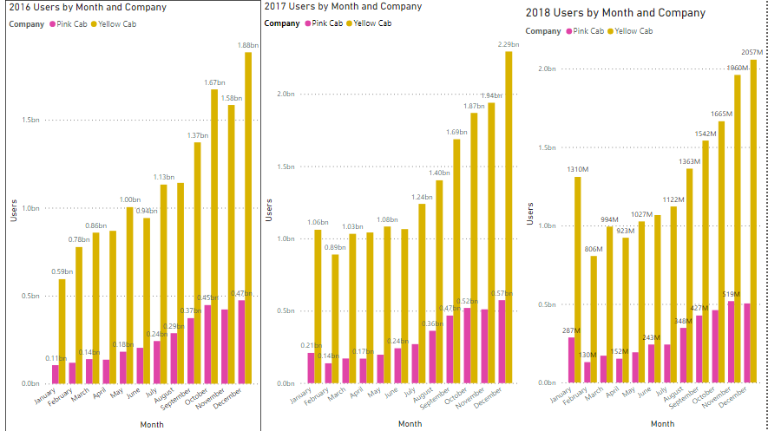
The company has maximum cab users at a particular time period.
Notes:
Q. Which company has maximum cab users at a particular time period?
The slide above shows both companies users over per month over three years. The busiest month of each year for each company is December.
The yellow cab company in 2016 1.88 billon users, 2017 2.29 billion users and in 2018 just over 2 billion users.
The pink cab company in 2016 0.47 billion users, 2017 0.57 billion users and 2018 0.51 billion users.

Slide 7
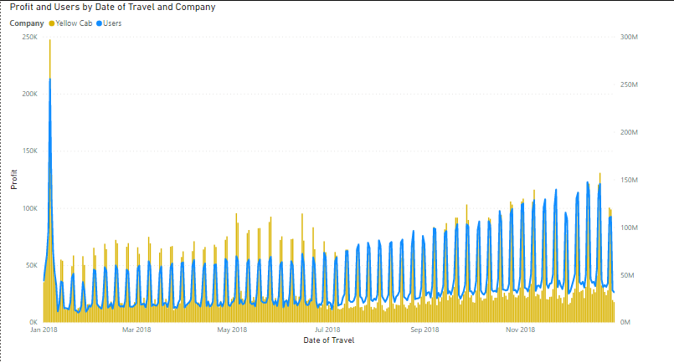
Yellow cab vs Users over time
Notes:
The graph here shows that Users of yellow cab affect yellow cab profits

Slide 8
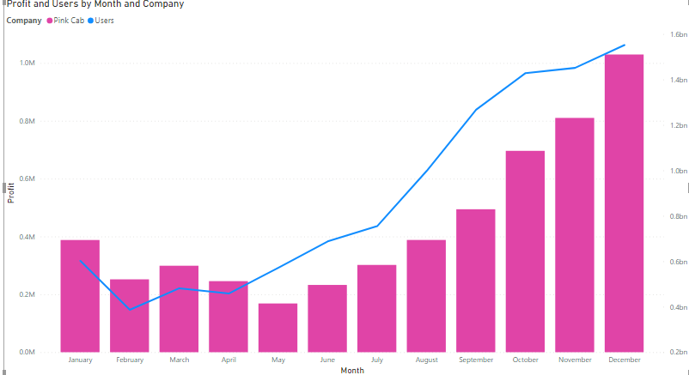
Pink cab vs Users over time
Notes:
Pink cab profit is also affected by users

Slide 9
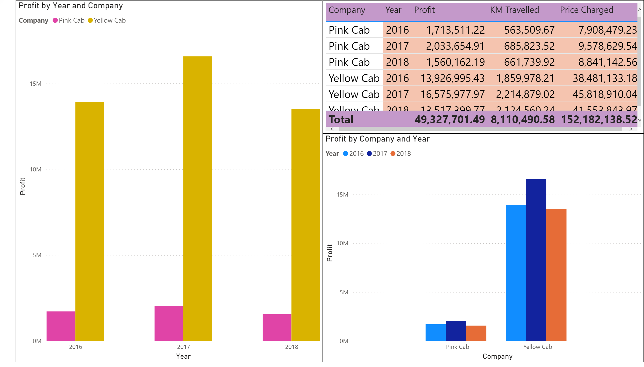
Profit Analysis : Profit per Company per year
Notes:
Does margin profit proportionally increase with increase in number of customers? Two slides.
This slide
Graph the profit yearly against the users.

Slide 10
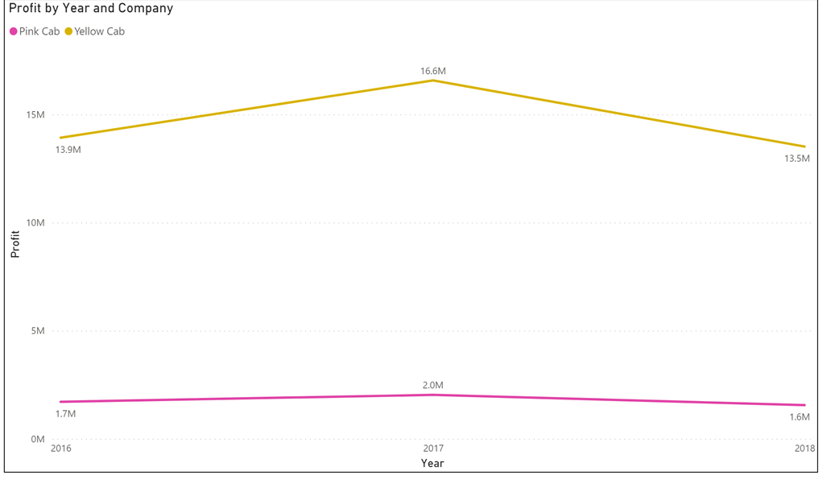
Profit

Slide 11
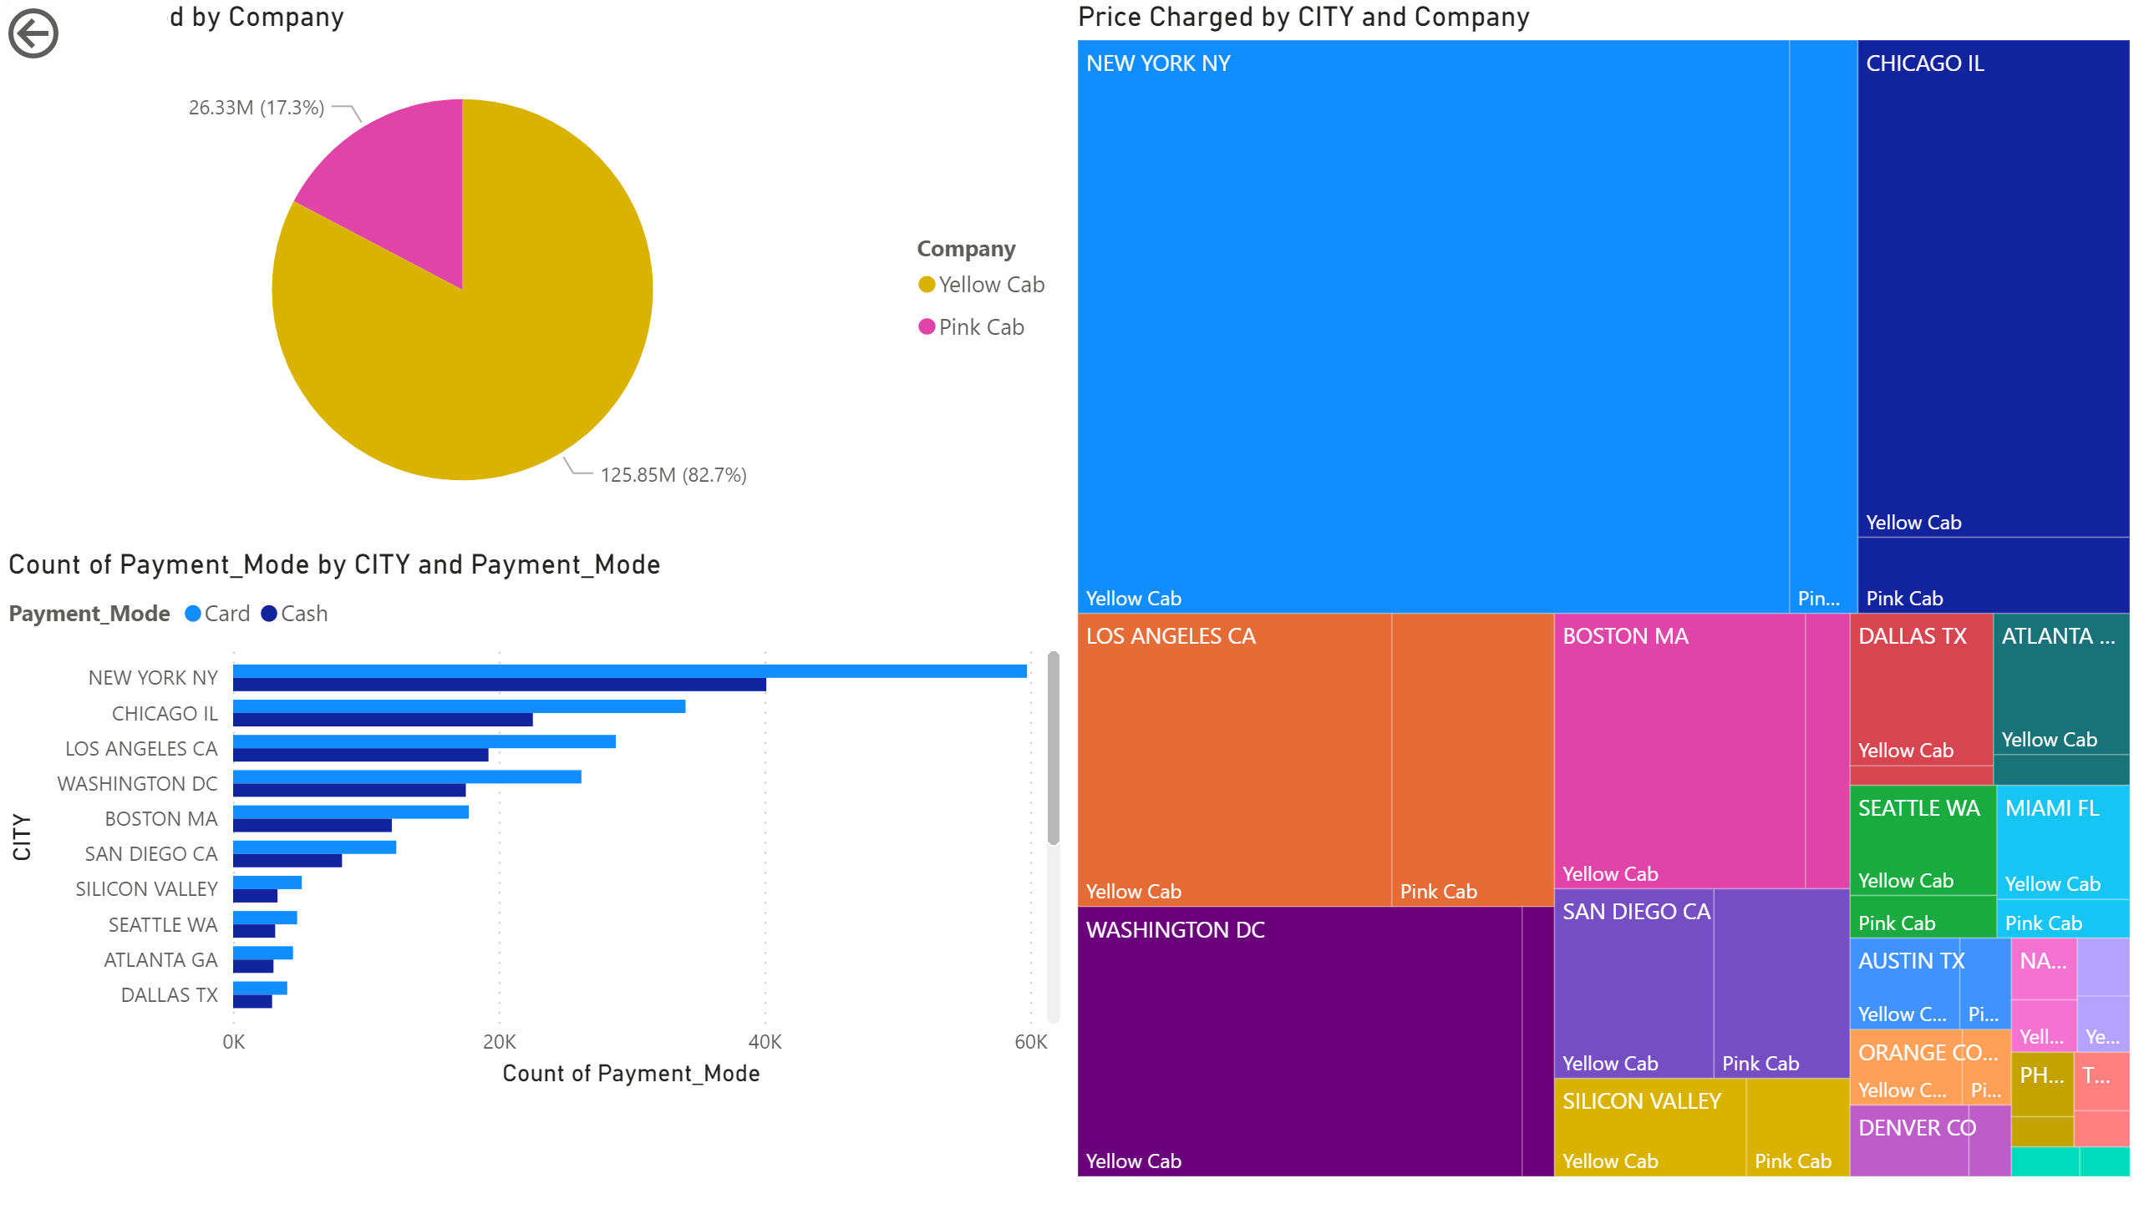
Preferred Payment method and Highest earning city

Slide 12
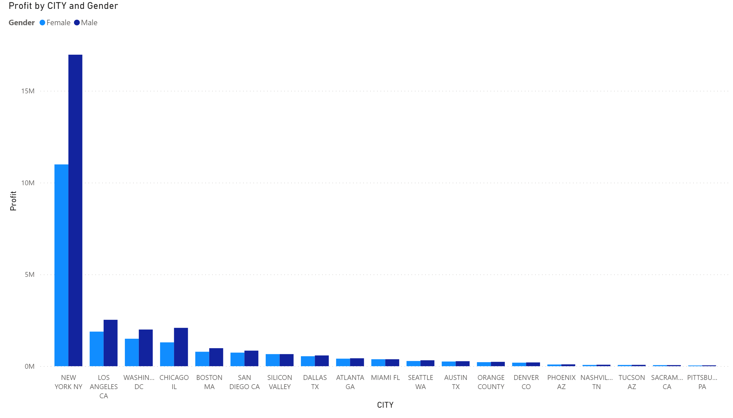
Profit by City and the Gender

Slide 13
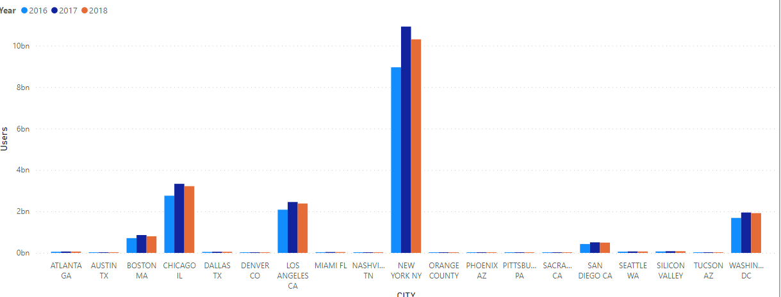
Cab users by city and year

Slide 14
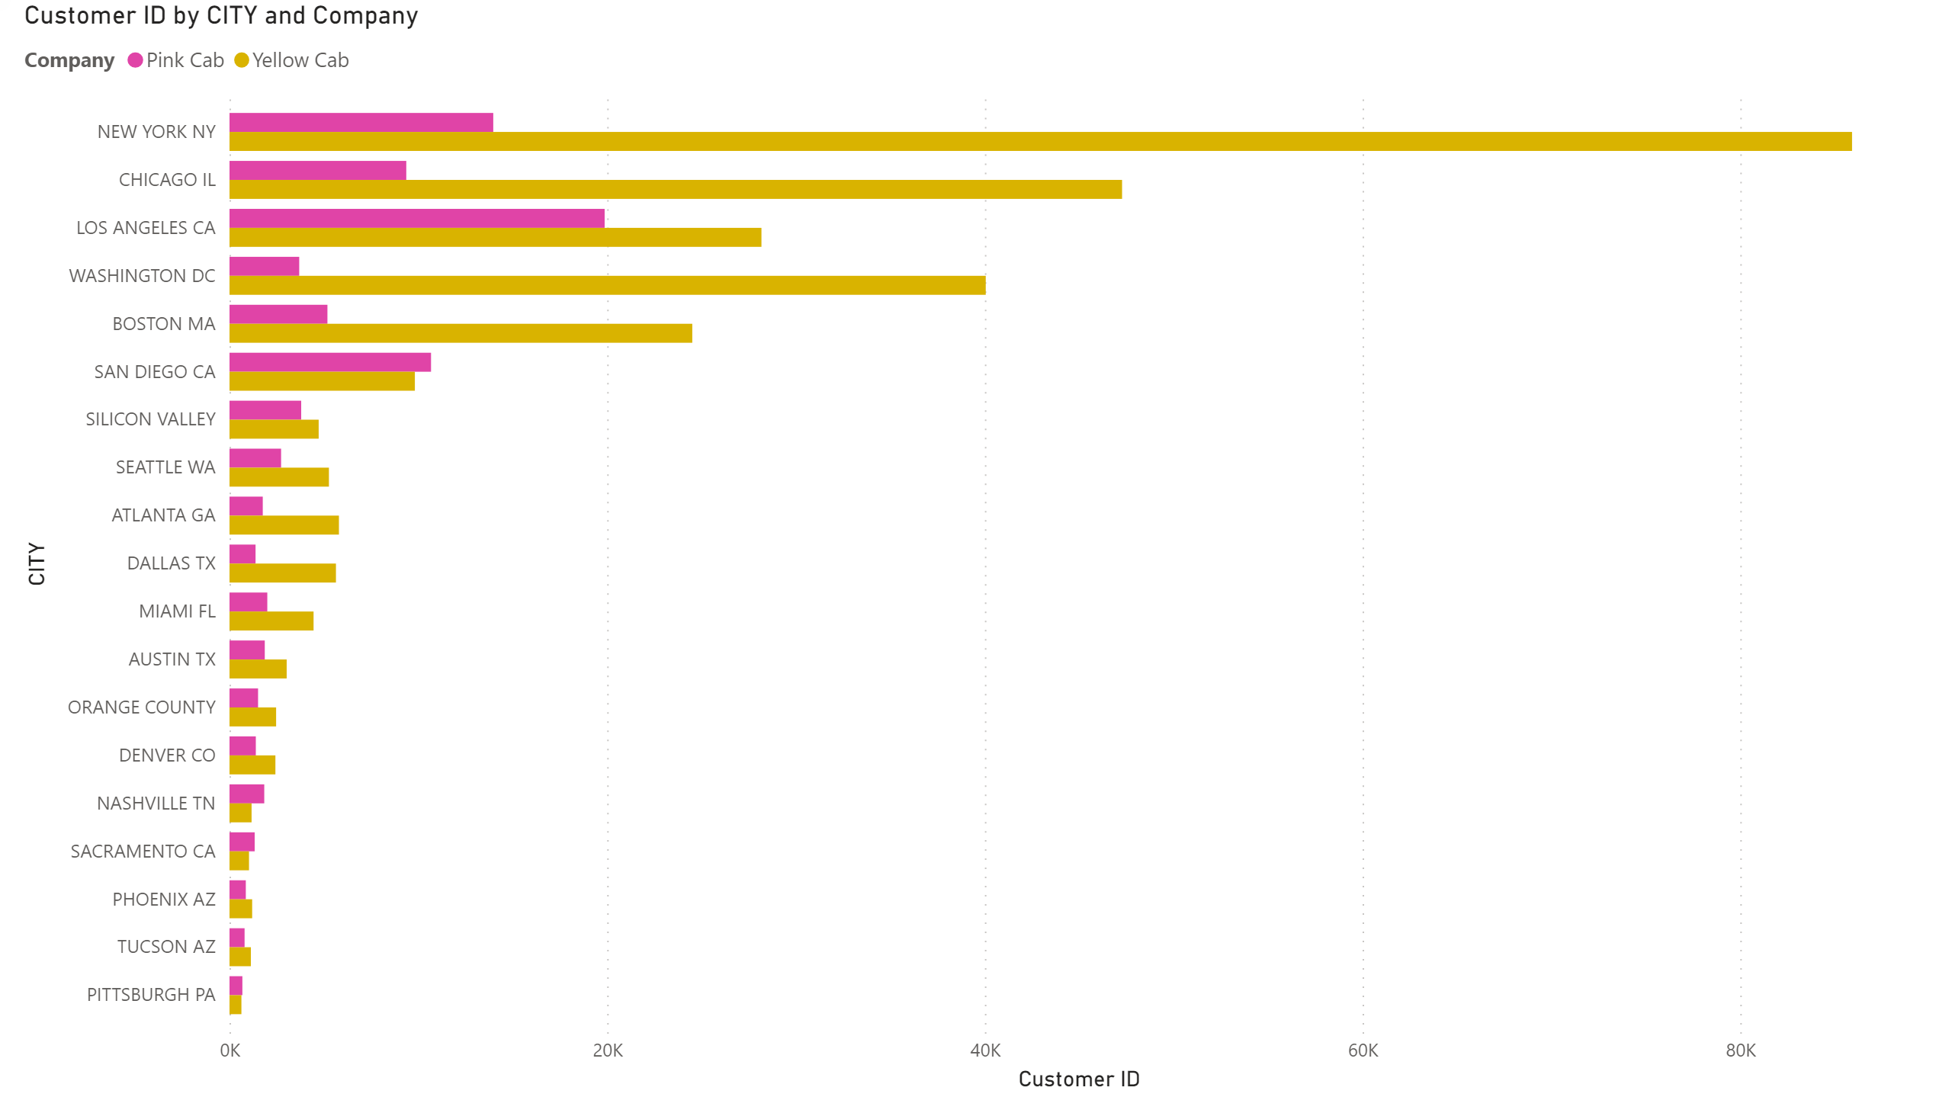
Customers by City and Company

Slide 15
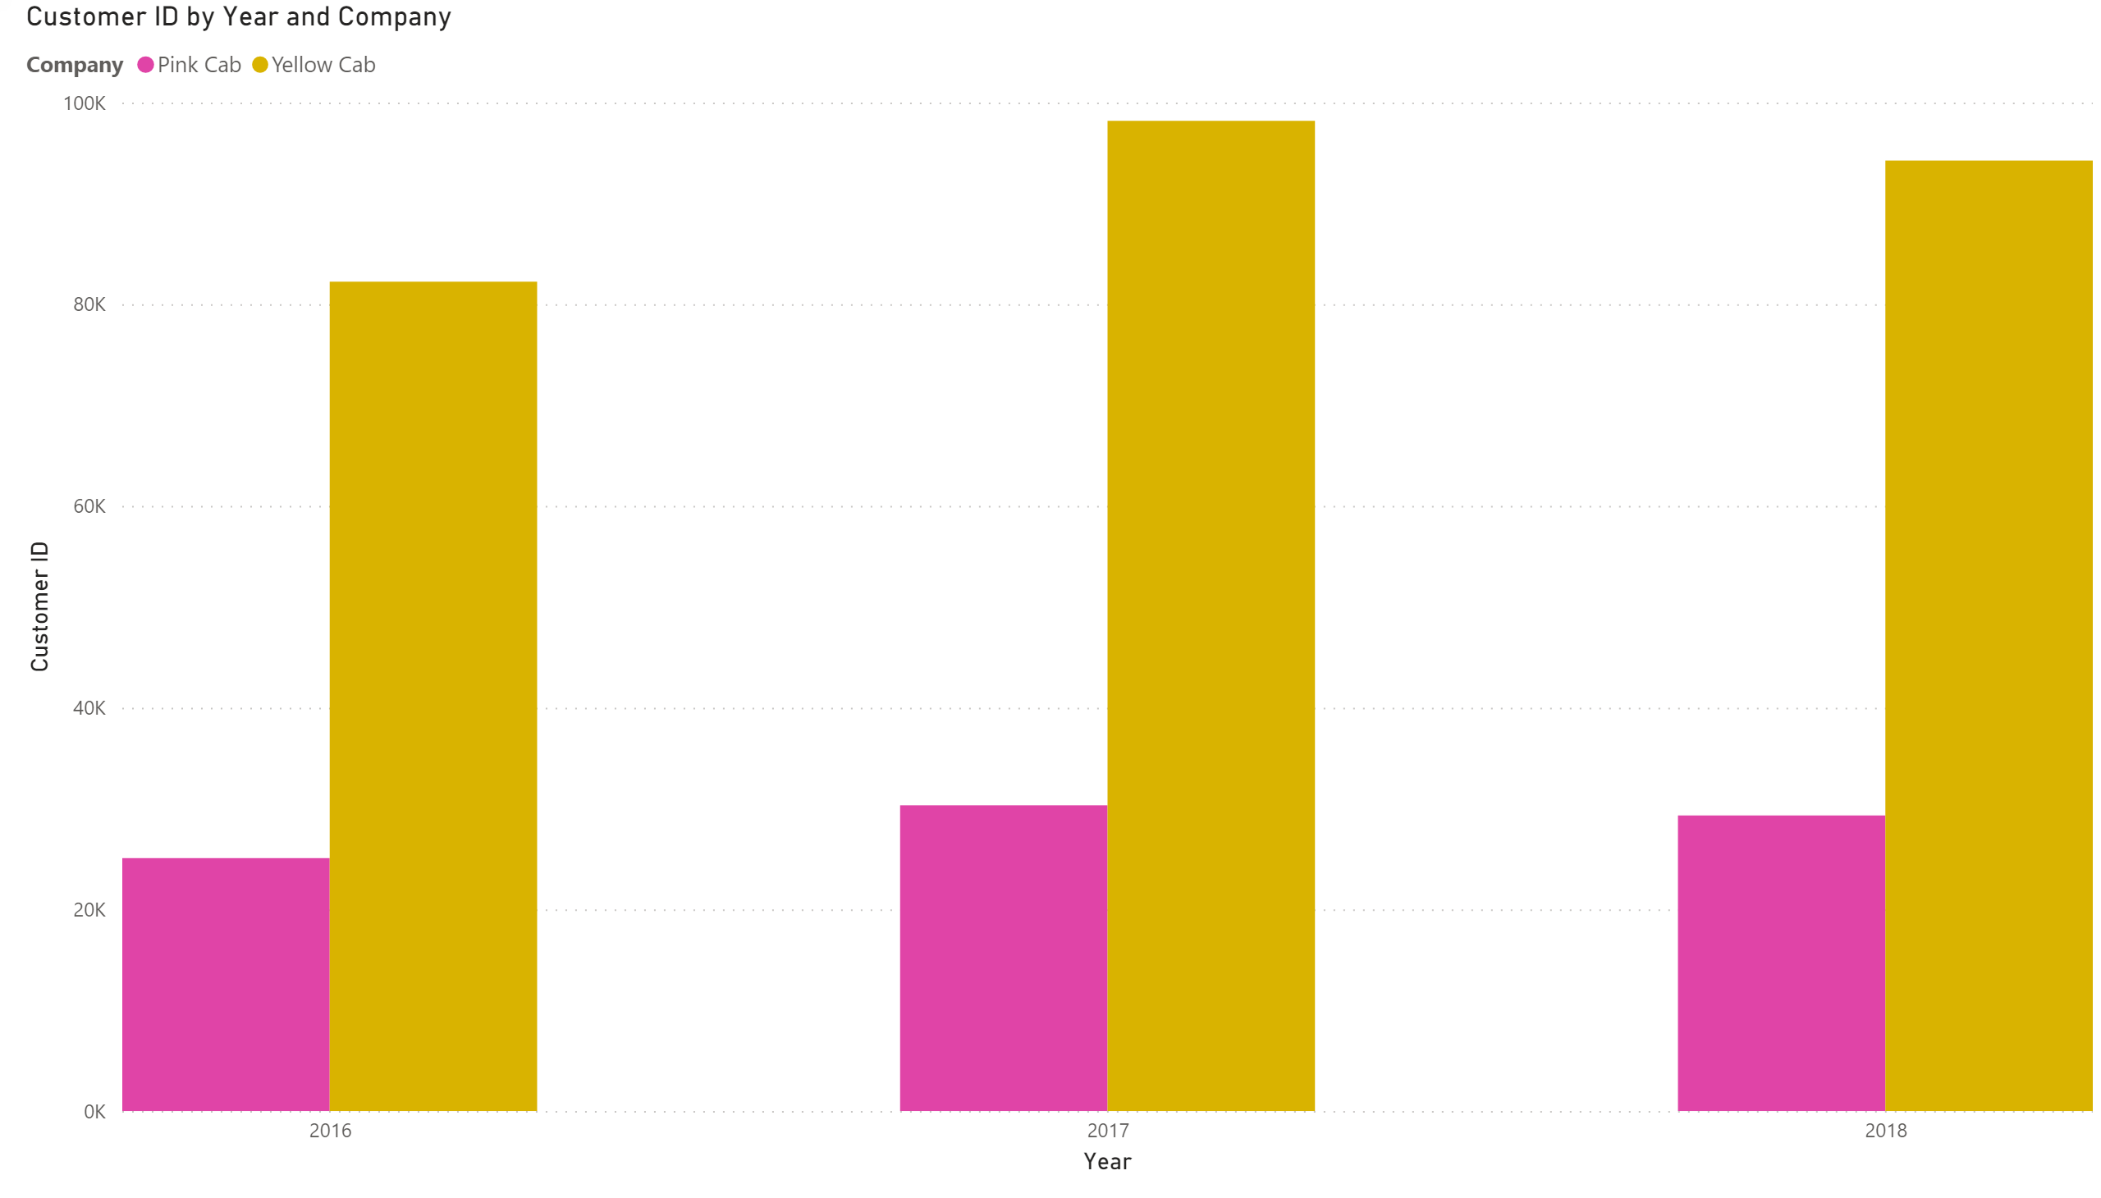
Customer by Year and Company

Slide 16
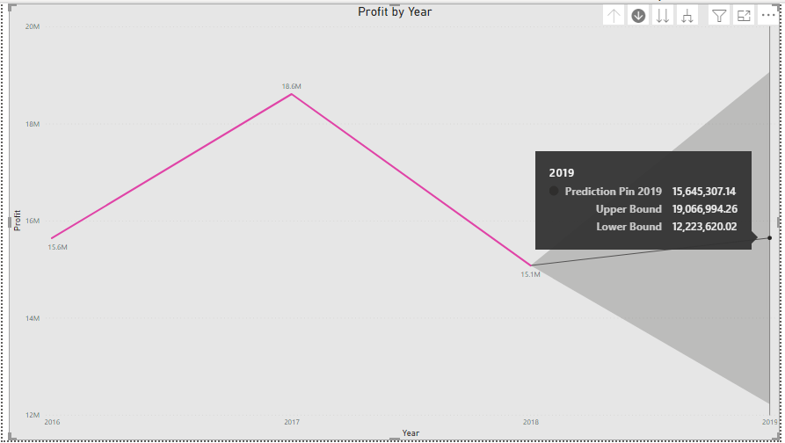
Predictions of Pink Profits for 2019

Slide 17
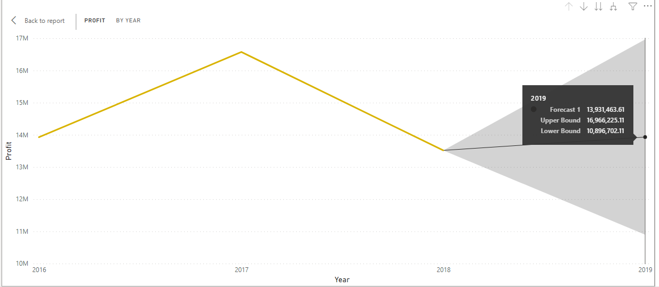
Predictions of Yellow Cab Company Profits for 2019

Slide 20
Summary
Yellow cab company is still the most popularly cab company on USA.
While the yellow cab company has prediction marginal profitability for 2019
Pink cab company has the ability to expand and take a greater market share

Slide 21
Investing in Pink cab company may give the best the return.
While yellow is a stable investment and can over time return a marginal investment .

Slide 22
Thank You

